Slide 1

Predicting the energy output of wind turbine based on weather condition.
By:
Durgesh KULKARNI
GUIDE: Prof. Jyoti lele

Slide 2

OBJECTIVE
To Develop a time series model to Predict the power output of wind farm based on the weather condition in the site
To Build an application to recommend the Power Grid to suggest the best time to utilize the energy from wind farm

Slide 3

SCOPE
The system can save the time for farmers to perform activities that are mainly performed using wind energy.
Energy suppliers can coordinate the collaborative production of different energy sources more efficiently to avoid costly overproduction.

Slide 4



TECHNOLOGY STACK
Python.
Streamlit.
Heroku

Slide 5
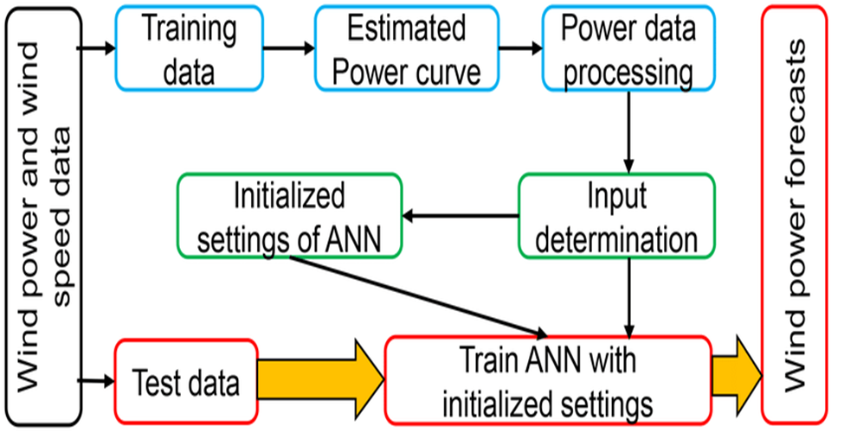
BLOCK SCHEMATIC

Slide 6

METHODOLOGY
Gather recent datasets of wind energy output from nearest power grid.
Machine learning model decision.
Estimation and prediction wind energy output based on weather condition.
Creating UI and linking it with python code.
Deploying the project to the cloud.

Slide 7
WORK COMPLETED
Collected the data from nearest power grid.
Cleaned the data and deleted unnecessary data values
Sorted the data into proper format.
Calculated the mean values of parameters.

Slide 8
THANK YOU

